Slide 1
This is a hidden slide
Dear honorable teacher please follow the instructions that has given in the slide notes (under the every slide). It would be helpful to take a successful class. Thanks a lot. I wish you good luck.

Slide 2

WELCOME

Slide 3


IDENTITY
SK. Md. Harunar Rashid
Senior Assist: Teacher
Sonatola Model High School,
Sonatola, Bogra.
Lesson
ENGLISH FOR TODAY
CLASS : SIX
UNIT : LESSON – 26

Slide 4
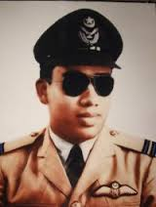
Look at the pictures
S: Yes, I know him. He is Motiur Rahman ,
Our freedom fighter.
T: Do you know him? What is he and his name?
Notes:
Teacher will show the picture for eliciting lesson declaration .

Slide 5
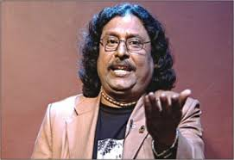
Look at the pictures
T: Ok. His name is Fakir Alamgir, a Bangladeshi famous singer and freedom fighter .
T: Do you know him? What is he and his name?
S: Sir, excuse me, he may be a singer but I don’t know his name.

Slide 6
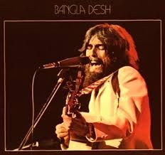
Look at the pictures
T: Do you know him? What is he and his name?
S: Excuse me sir. We don’t know him. Please , say about him.

Slide 7
His name is George Harrison. He is a famous singer and humanist from England . He helped us during our Liberation War of 1971 by organising The concert for Banglsdesh to make the world aware of the sufferings of Bangladesh during our liberation war. So he is also a freedom fighter of Bangladesh.

Slide 8
Let’s enjoy the concert
The concert for Bangladesh.

Slide 9
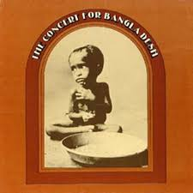
LESSON DECLARATION
So today we`ll discuss about
The Concert for Bangladesh

Slide 10
Learning outcomes
After completing this lesson students we will be able to-
read and understand texts
ask and answer questions
Participate in short dialogues and conversations on familiar topics

Slide 11
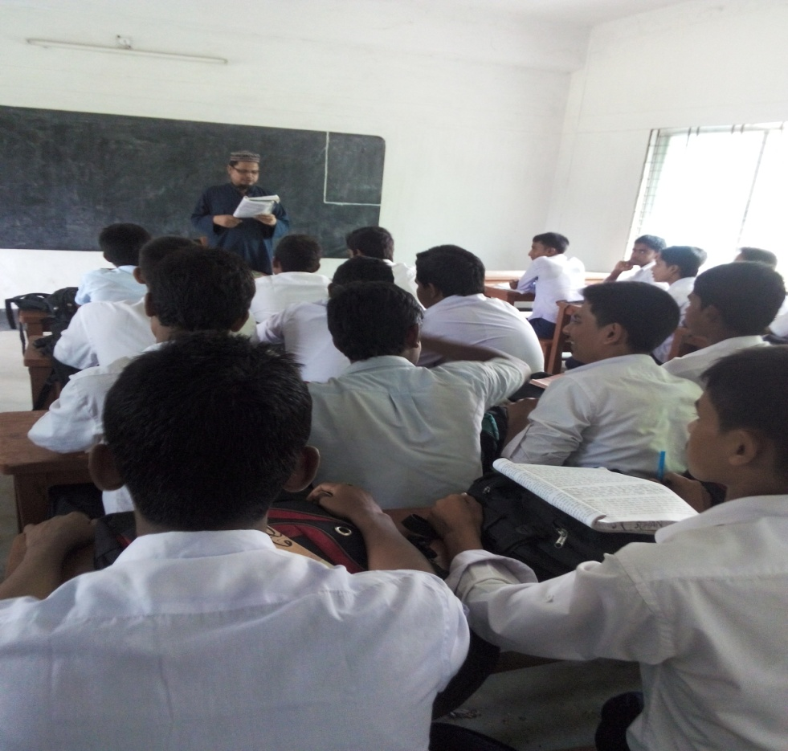
Model reading
At first listen to me. Then discuss in pair, if the following statements are True or False. If false, give the correct statement.
Notes:
This slide only for model reading task for students in the next slide.

Slide 12
Pair Works : True / False
George Harrison was from the United States.
b. In 1971, George Harrison visited Bangladesh to take part in the liberation war.
c. A huge audience attended the concert for Bangladesh.
George Harrison was the only well-known musician to take part in the Concert for Bangladesh.
The people of the world became aware of the crisis in Bangladesh following the concert for Bangladesh.

Slide 13
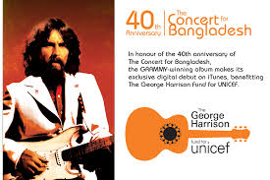
Vocabulary
Try to say the meaning of the following word and make sentence.
A performance of music and singing
Concert
George Harrison and some other musicians performed the concert.
Notes:
First, the word will be shown, SS will be asked to pronounce the word. If it needed teacher will help. Then the picture will be shown and asked to guess the meaning. After that the meaning will be shown. Then they will be asked to make sentence. Teacher will show the students for the feedback. Slide 12, 13 and 14.

Slide 14
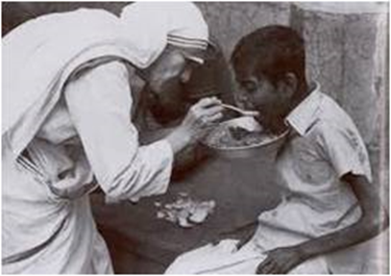
Vocabulary
Person who shows sympathy and kindness towards others.
Humanities
Mother Teresa was a famous humanitarian.

Slide 15
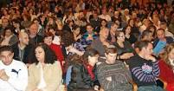
Vocabulary
The people who sit and watch a perform
Audience
The audience enjoying the concert.

Slide 16
Individual Work
Read the text carefully and put a word in the gaps from the box matching their meanings.
struggle
organise
Take part
aware
relief
a. ---------------- = to be involved in an activity.
b. ----------------- = having knowledge of a particular thing.
c. ------------------ = to fight.
d. ----------------- = help
e. ----------------- = to make arrangement.
Notes:
Teacher will give sometimes for eliciting correct answer then he can give feedback.

Slide 17
Pair Works
Read the text again and write a short paragraph on ‘’The Concert for Bangladesh’’ using the following clues. Follow the order of information in the text.
The concert for Bangladesh
Its organizer ---------- reason behind it ---------- its aim ---------- its effect -------- its significant.
Notes:
Teacher can help the learners.

Slide 18

HOME WORK
Take a interview of a local freedom fighter and write down it.

Slide 19
THE END

